Slide 1
Intelligent Transport System
ITS may be considered as a holistic transportation management and service system which aims to provide innovative and user-friendly services relating to different modes of transport
ITS uses a network of IoT sensors as the underlying basis for these innovative solutions to transport management. These sensors help in capturing data in a real time and feed the data to various networked subsystems of communication channels and data processors.
ITS through the implementation of its subsystems, collects relevant data, processes it, and hands out the solutions to problems and concerns at hand in various aspects that might be encountered during travel, ranging from road safety, congestion management, traffic rules implementation, to catering to ever-evolving needs of passengers

Slide 2
Intelligent Transport System
These subsystems are often battery driven and run on low-power energy source but need energy optimization to make the whole system energy efficient.
Optimization of energy consumption is an important aspect of the design, development, and implementation of an effective and efficient smart transportation system.
Techniques such as multisourcing and sectionalization storage may be used to minimize the energy consumption in the transfer of data during the process of information from sensors

Slide 3
Intelligent Transport System
Apart from segmental energy optimization, power harnessing at macro-level may be planned to achieve energy efficiency of the ITS systems.
Like any other systems, ITS also has some operational issues which need to be addressed to make it highly productive and efficient.
Some typical issues associated with communication process like congestion, clashes, and resource allocation may be resolved by employing various methods like use of routing algorithms with optimized duty cycle and latency determination, resource time scheduling, unsynchronized intelligent learning based resource management, etc.

Slide 4
Intelligent Transport System
Because of its effectiveness and efficiency, ITS is emerging as a promising tool to provide high-quality comprehensive transportation management and service systems.
But major challenge lies in making the system energy efficient as whole through energy optimization of subsystems by employing innovative optimization techniques.

Slide 5
Motivations for IoT in Transportation
Due to rapid growth of vehicular traffic, all major cities are facing various problems
According to the study conducted by Boston Consultancy Group in January 2018 in India, traffic congestion in peak hours in four major cities, namely, Delhi, Mumbai, Bengaluru, and Kolkata costs the economy 1.47 lakh crore annually, in addition, causing air pollution.
The peak hours for this survey were 7–9 am and 6–8 pm during which commuters spent one and a half times more to travel a given distance as compared to nonpeak hours.
If appropriate measures are not taken, the situation may become worse in future as on an average 89% of commuters indicated their plans to purchase a car in the next 5 years.

Slide 6
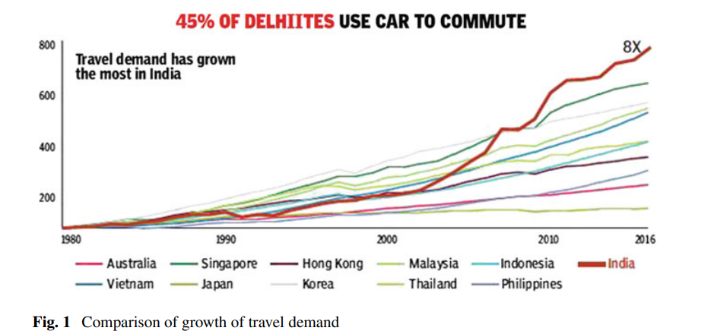
Figure 1 depicts the surge in the travel demand in India in comparison to some other countries.

Slide 7
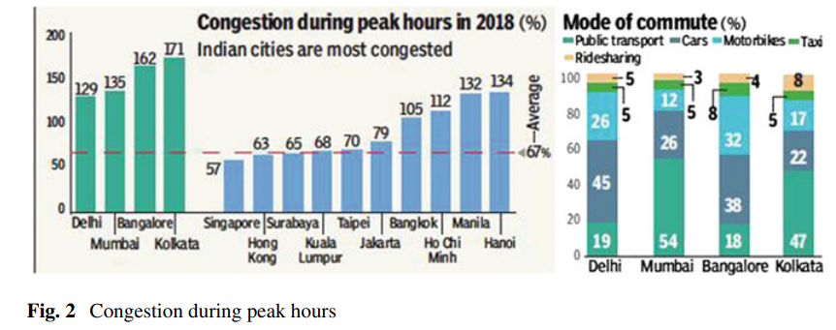
Figure 2 shows the congestion data for four major cities of India as compared to that for some other countries

Slide 8
Motivations for IoT in Transportation
Majority of vehicles run on fossil fuels and vehicular emission is one of the prime sources of air pollution.
An inefficient transportation system compels the vehicles to burn fuel for longer time which results in twofold problem of uneconomical energy consumption as well as worsening the air quality which has already reached an alarming level in many cities of the world.
It is proven fact that vehicular speed and smoothness of traffic flow have direct relationship with energy consumption and vehicular emissions.
As per a study conducted by IIT Kanpur in 2015, transport alone contributes to 22.55% of all particulate matter in Delhi

Slide 9
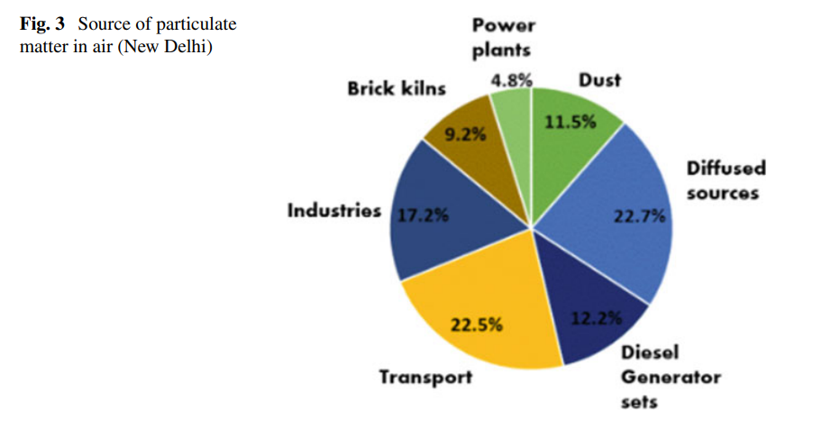
Motivations for IoT in Transportation

Slide 10
Motivations for IoT in Transportation
Minimization of energy consumption and vehicular emission is the major challenge for sustainable development as well as for healthy life.
The search for an effective and efficient solution culminates at development of an ITS-based multipronged strategy
ITS provides a gateway for efficient fuel usage, road navigation, travel support, route perception as well as environment awareness that shall ultimately minimize the risk of or culminate the causal factors to the above-discussed problems perceived in transportation

Slide 11
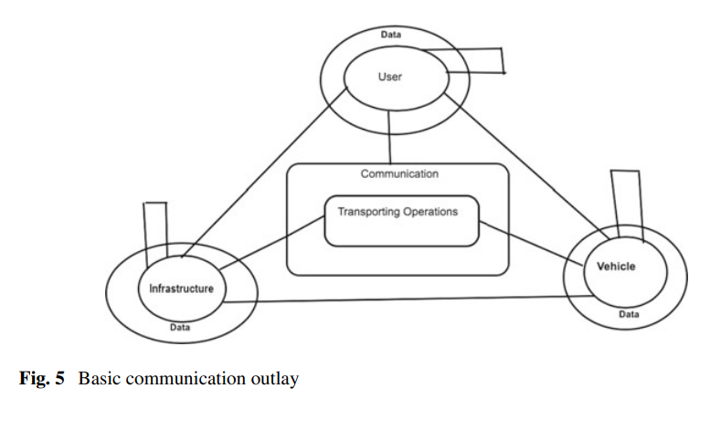
Communication Technology and Related Power Issues
Communication is the next layer of ITS technology strata, filling the gap between sensing technologies, actuation processes, etc. and the computational and information processing levels. Interconnection of various entities involved in the subsystems of ITS is the basic functionality of this layer

Slide 12
Communication Technology and Related Power Issues
Information exchange network models in ITS can be crucially subdivided as follows: Vehicle to Vehicle and Vehicle to Infrastructure.
ITS schemes widely use vehicular-based sensing equipments and electronic systems, that need in vehicle communication networks to share with and derive data from peer vehicular systems, defined as vehicle-to-vehicle communication models (V2V).
These networks can be employed on various communication protocols based on the applications they serve, feeding on different data transfer ranges.
Data pertaining to driver control and passenger monitoring generally uses a data transfer rate of less than 10 Kb/s.
This array of communication technology works on protocols based on low-bandwidth functionalities, often having a very limited range of data transmission, like local interconnect network (LIN), time-triggered weight protocol (TTP/A), etc

Slide 13
General road data, generally not related to diagnostics or critical information, but more on route conditions, often uses 10–25 Kb/s transfer speeds, with transmitted data often being buffered transfer service based. It might include information pertaining to temperature, humidity, sound levels, among other things.
They function on communication networks based on controller area network bus (CAN-B), J1850, etc. Information transfer and transmission pertaining to powertrain and chassis and other diagnostic elements also employ controller area network bus (CAN-B), though at a highest speed of transmission ranging between 125 Kb/s–1Mb/s, given the importance it holds in the actuation processes

Slide 14
High data consuming applications like multimedia and infotainment applications, that use greater bandwidth, are transmitted at over 1Mb/s transmission speeds. Such transmissions generally contain information relating to higher technology employments in ITS systems
Such technologies use protocols like media-oriented system transport (MOST), digital data bus (DDB), Bluetooth, FlexRay, ZigBee, Wi-Fi, ultra wideband (UWB).

Slide 15
Vehicle-to-infrastructure (V2I) model is based on wireless information exchange of data between vehicle and the roadside infrastructure to improve transportation system performance.
This exchange is that of operational data, often critical for safety and smooth traffic management. Many different exchange technologies have been proposed in this domain as follows: 4G/ LTE technology, providing transmission speeds up to 128 Mb/s and a decent ground coverage

Slide 16
Vehicle-to-infrastructure (V2I) model is based on wireless information exchange of data between vehicle and the roadside infrastructure to improve transportation system performance.
This exchange is that of operational data, often critical for safety and smooth traffic management. Many different exchange technologies have been proposed in this domain as follows: 4G/ LTE technology, providing transmission speeds up to 128 Mb/s and a decent ground coverage
Vehicle-to-infrastructure (V2I) model is based on wireless information exchange of data between vehicle and the roadside infrastructure to improve transportation system performance.

Slide 17
This exchange is that of operational data, often critical for safety and smooth traffic management. Many different exchange technologies have been proposed in this domain as follows: 4G/ LTE technology, providing transmission speeds up to 128 Mb/s and a decent ground coverage
Buffering might be a solution to mobile information exchange, though having its own drawbacks like information overload and slow interfacing. Distributed computational systems involved in ITS also might require efficient resource allocation in network overlay for higher system efficiency and power optimization.
Improvement in paging cycle as well as redirect mechanism of the protocol involved might also add to the energy efficiency issues of the communication network

Slide 18
Device synchronization also might create problems, leading to a higher energy consumption by the networks involved in device-to-device information exchange
Collision and network jamming are some other issues that might lead to consumption of higher than intended transmission time, at the same time prolonged occupation of the transmission queues hence bugging the data transfer, increasing the operational energy demands.
The above-discussed problems can be categorized into three major domains that are communication and congestion based problems, duty-cycle-based problems, and transmission resource allocation and management. These shall be discussed in the later sections, with solution to problems stated

Slide 19
Information Extraction and Underlying Power Issues
The data processing systems of the transport schemes, like in any other industry, keeps growing in the scale of data needed to be crunched, leading to rapid growth in data to be managed and the complexity of information system schemes.
This rise in data volumes and the technology upgrade needed to support the new definitions on
efficient and accurate information processing systems which have called for more complex data management schemes.

Slide 20
The problem faced in implementation of such advanced schemes are
(1) ITS prefers embedded computational systems that may pair in easily with sensing technologies to make individual intelligent entities and reduce network transmissions needed in the process, though the scale of data processing needed formost applications might need a heavier processing unit than an embedded computing scheme,
(2) sophistication of processing units also mean an increase in power consumption by the computational schemes, bringing the energy efficiency of the system down, and
(3) centralization of data management systems, due to need of nonmobile, deep deciphering computational units, might lead to an increased dependency on communication networks, increasing its load, cost of operation as well as power consumption.

Slide 21
Information processing schemes largely depend on the perception technology employed in ITS systems
Simpler schemes of sensing, having no intelligence of their own, depend highly on data processing schemes for decision-making and data inference.
Median models of sensing have a lower dependency on computational schemes, though depending on applicability of a particular system, and they might require higher computational support for their functioning, especially those involving visual interpretation and detection.
Advanced schemes of perception often are heavily dependent on, and work hand in hand with data processing systems.
Given the vital dependency on computational systems, each of the above-categorized systems shall find optimization solutions in data processing energy efficiency.

Slide 22
Balances between the accuracy of computational schemes and their respective energy efficiency need to be found during the implementation of any data processing scheme.
The computational schema need to take care of all the aspects of data processing elements while searching for an energy-optimized solution, addressing the various sensing structures it serves to, taking care of rules the accuracy set by their applications.

Slide 23
Energy Efficiency Challenges and Corresponding Solutions
Precision, Density, and Reliability of Perception and Smart Sensing Solutions
An array of sensing technologies are involved, as discussed before, which shall be used individually or in combination. The decision of making this choice depends on the level of precision needed for a certain application as a subsystem and its underlying goal to be served.
Now, the various technologies can be categorized as intrusive and nonintrusive.
Intrusive sensors are those, which, as the name suggests, need physical contact with the object under mensuration, for example, pneumatic tube, inductive loop sensors, piezoelectric sensors, etc.

Slide 24
Non-intrusive sensors do not need direct contact for making measurements, for example, RFID, electroacoustic transducer, etc.
Intrusive transducers often need integrated installation with the infrastructure, and hence need preplanning for installation and are harder to maintain, though, often having negligible operational power consumption.
Nonintrusive transducers have advantage of easy installation and maintenance, though, often needing higher operational energy.
Above might be a parameter for selection of sensing technology needed for application.
As said before, the degree of precision needed for some actuation is an important parameter for selection of a sensing technology

Slide 25
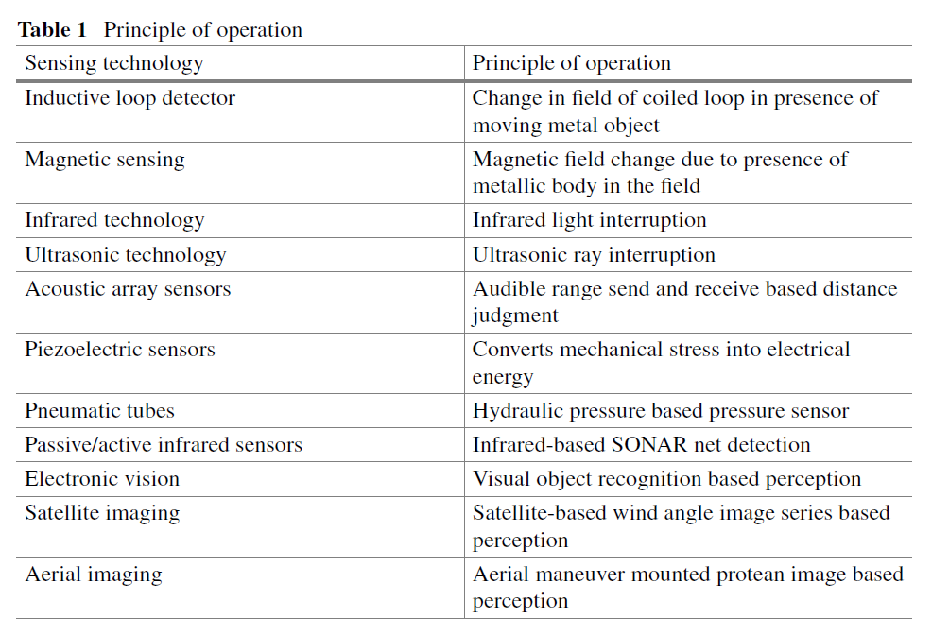

Slide 26
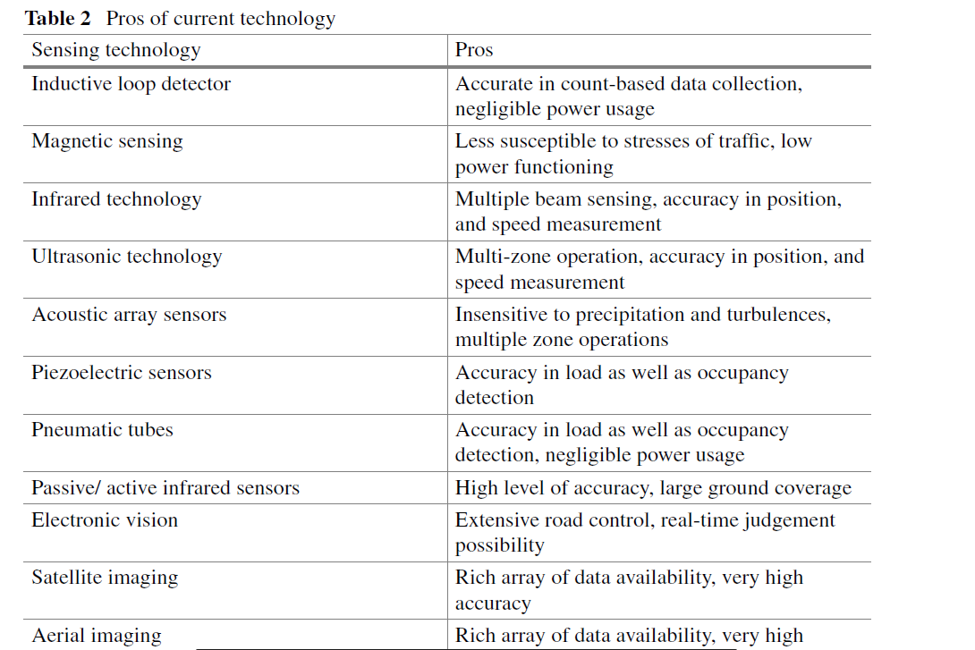

Slide 27
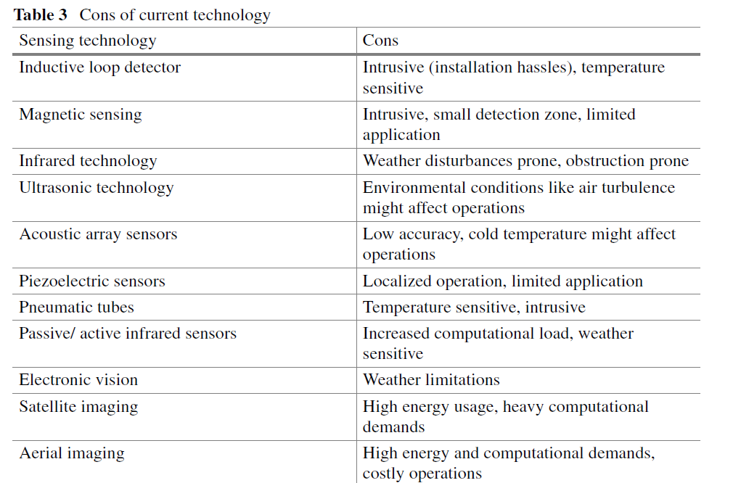

Slide 28
Information Exchange Based Solutions
3.2.1 Congestion-induced energy conservation management
Congestion and resource overflow leads to blocking of communication network, leading to delays, and hence increasing the power consumption of the communication system.
Some propositions to deal with the same given as follows.
For back-off mechanism of resource allocation, employment of extended access barring (EAB), using an extended wait timer and delay-tolerant indicator, is done so as to create a differential window for different sized packets instead of slicing of data, controlled on parameters of access delay and access probability, and hence providing energy efficiency.
Extending the EAB to four paging cycles further shows improved efficiency in energy usage as well as resource distribution

Slide 29
Resource allocation to modulation and coding scheme (MCS) is the key factor in energy-efficient communications.
It inhibits congestion and implements overload control due to intrinsic properties of choosing optimal MCS.
Association of picking transmit power with MCS determination adds to the energy efficiency brought in by this method
Clustering of devices, with treatment of each as a mobile node, and hence opportunistic usage of available memory related to each as a temporary buffer decentralizes the load on central buffer and communication network, bringing down the network congestion in the process.
It also saves energy by curtailing the need for transmission of data to the central exchange

Slide 30
Reinforcement of learning algorithms for selection of enabled node-B (eNB), with access probability as its metric for choice, shall help in distributed and dynamic networking, with median mobile nodes acting as forward feed buffer, localizing and sectionalizing communication, and hence decreasing the overall congestion.
Other methods like avoidance of near simultaneous communication requests with larger back-off values to give a relatively spacious network time slicing and reference signal blocking based on statistical methods are also proposed, with simple yet effective implementations in employed protocols.

Slide 31
Duty Cycle Adjustment for Energy Optimization
Synchronization between various uplink and downlink message slots for different messages in the transmission queue is important to avoid disruption in transmission and intermixing, leading to a corrupted communication.
Various schemes for different types of communication have been proposed for the same.
Proposals of random access to communication resources have been made for LTE-based communication systems, extendable to higher speed communication technologies having similar working principles.
Here, we use frequency time division for bandwidth allocation for physical transmission channel known as physical random access channel (PRACH) here.
This allows us to establish a radio resource control (RRC) that ultimately serves the goal of bandwidth division.
Connected nodes in this network are informed of availability of PRACH resources through a broadcast or other downlink channels by the evolved node-B (eNB).

Slide 32
When connection is sought by a device, a series of request and acknowledgement messages are sent, finding an eventual resource slot for the said message, and hence partitioning time slots on bandwidth, restricting information collisions.
Heuristic approaches to transmission control have been proposed for a more judicial and responsive bandwidth slot allocation, and hence improving message delivery cycle synchronizations.
Proposition for multi-hop network employments has been made, with packet buffering strategies being included so as to lower the load on duty cycle.
Such models employ schemes like restricted access window mechanism that allow multihop- based duty cycles with opportunistic data transfer approaches.

Slide 33
Such schemes combined with the low-power radio transmission they work on, largely help in building an energy-efficient system for transmission More duty cycle definition algorithms for commonly used protocols have been proposed, notable ones being frame slotted
Aloha and tree splitting algorithm based duty cycle synchronization, that are targeted specifically to tackle common duty cycle issues and analogous problems occurring in mobile as well as static machine to-machine networks

Slide 34
Power issues in this domain occur due to conflicting claims over duty cycles, uplink/ downlink collisions, and inefficient bandwidth distribution, each of which has been dealt with through the implementation of the solutions, chosen as per requirements for improving efficiency of the system used

Slide 35
Energy-Efficient Utilization of Radio Resources
Extension of frequency allocation techniques like orthogonal frequency division multiple access (OFDMA) and single-carrier frequency division multiple access (SC-FDMA), predominantly used in
LTE-based systems to other high-frequency transmission technologies, is considerable, given the high spectral efficiency as well as peek-to-peek average power ratio reduction these implementations present.
Proposal of LTE-based system models employing relay networks, with employment of two-phase probabilistic approach resource division have been made.
The first phase includes each transmitting node to heuristically select physical resources based on modulation and coding schemes used, such that each node tries to transmit at the minimum power by using the physical network associated with lowest channel quality indicators for the given transmission.

Slide 36
If the amount of required resource of transmitting node exceeds the total amount of radio resource, then the second phase is executed. The second phase involves fitting the total required transmission time interval (TTI) of nodes to the sub frame space and satisfies node requests by tuning the transmission power of all transmitting nodes and employing concurrent transmission.
Intelligent segregation of the contention queue on basis of communication range can be employed, with multi-hop-based, low radius transmissions using IPv6 supported over Bluetooth low energy (BLE), making use of integrated user transmissions, lowering the load on infrastructure-based communication resources, promoting vehicle-to-vehicle communication

Slide 37
Computational Feasibility and Distributed Computing Solution
Simple computational schemes include direct actuation instructions based on input parameters by the sensing scheme associated.
Such a solution is highly simplistic and power efficient and might be useful in functioning of subsystems, tough given the naiveness of approach, which might not be useful for larger designs.
Prediction-based computations might be brought into use for applications like lane sensing, traffic proximity warning, speed, mobility of maneuver, etc.
These systems can be made energy optimized by lowering number of computations required, by usage of previously occurrences and inclusion of learning in the prediction process

Slide 38
Location-based sensing requires employment on positioning systems, that require Cartesian-based computations, and are often trivial.
Though, processing of this data for inference of other parameters like traffic congestion comes under big data processing as discussed later.
Assistance-based applications require data processing for churning out the required information, which in turn employs heuristic logical computations for the application.
Power usage can be brought down by the usage of various methods to improve the classification computations, which serve the basis of such schemes.

Slide 39
Assessment-based applications often require processing of big data.
Big data is processed using tools like Hadoop, though having quite a complex structure of problems and computations.
This implies high power consumption, and hence low power efficiency. Since the complexity of big data problems directly depends on the size of data to be processed, sectionalized data processing might help in making the processes energy efficient.
Apart from this, planned usage such as decentralization of computational schemes, distribution of computational load on local machines of subsystems, multisourcing computational load from willing user devices, etc are some other proposed schemes that might be employed

Slide 40
Data Collection and Pooling with Energy-Efficient Solutions
Data collection and storage, both, largely depend on and work in conjunction with data analysis scheme, and hence implementation of physical layer for data agglomeration structure is dependent on computational practices in use in our model.
With these two subsystems (namely data collection and storage) being preponderantly codependent, a joint scheme, recognizing the optimization prospects for the blueprint of computational system shall be implemented
Buffered data is of great importance when it comes to mobile ad hoc communication that is predominantly used in the ITS communication networks.
The data buffer storage optimization is important when it comes to ITS, which in turn shall improve the energy efficiency of the associated subsystem.

Slide 41
Many optimized buffer schemes have been proposed, which promote efficient handling of variable-length packets and forwarding them in a non-first-in first-out (FIFO) order, but rather on the basis of demand, employing multiple switches.
This not only guarantees a lesser time delay in the storage and retrieval process, but also assures a rather low congestion on delivering communication network.

Slide 42
Big data being an integral part of ITS informatics system, it is important to tend to the collection and storage issues relating to this dataset.
Big data, being unstructured, non-segregated data, requires management in accordance with the approach of computations associated.
Storage through segregation is an efficient way of breaking down unstructured data and manipulating it locally, as discussed before, and then clubbing the analyzed data from decentralized storage and computational scheme

Slide 43
Further Challenges and Opportunities
Further Involvement of Internet of Vehicle (IoV)
Internet of vehicle (IoV) is an extension to Internet of things (IoT) applicability.
With IoT finding its roots in various domains, its usage in transportation has urged the evolution of intelligence in vehicles, leading to emergence of usage of ad hoc networks in vehicle-based sensing technologies
IoV has been made feasible for implementation in contemporary ITS schemes, proving to be highly useful, smartening individual vehicles as ITS network nodes, decreasing the load on infrastructure-based resources and increasing the environment as well as road condition awareness of passengers

Slide 44
IoV is an integration of three networks: an inter-vehicle network, an intra-vehicle network, and vehicular mobile Internet.
Inter-vehicle network allows an ad hoc network between neighborhood vehicles, allowing information between them, and hence improving the data exchange in terms of quality of service (QoS), while at the same time reduces infrastructure communication network congestion Intra-vehicle network connects various vehicular-based sensors, creating a miniature model of ITS based systems inside a vehicle itself, allowing better access to vital road parameters on the wheel, with lesser dependency on the infrastructure resources.
Vehicular mobile Internet provides connectivity to infrastructure resources and other data access that shall not be obtained by perception technology installed in the vehicle itself.

Slide 45
Cooperative Automated Vehicle (CAV) Scheme
Cooperative automated vehicle (CAV) provides a trust-based secure communication platform, allowing exchange of information in a secure way, and hence seeing to our worries toward potential system failure and possibility of identity theft.
This scheme allows collection of data from all elements that are involved in the ITS system, promoting decentralization of operations involved, lowering the load on infrastructure-based resources, and hence increasing power efficiency of the system, while seeing to the security and robustness against potential attacks.
CAV finds its best application in conjunction with implementation of IoV.
Together, they can be used to design a paradigm designed intricately to complement each other.
Having a promising application in future implementations of ITS blueprints, this is one of the major technologies to be explored in the field.

Slide 46
Utilization of Multiple-Source Data in ITS
Data collection and processing face many problems like corruption of data, agglomeration issues, computational overload, buffer and storage overflow, central storage, or computational hardware.
Multisourcing of data provides a solution to all such problems that data agglomeration of coherent data and its related computational schemes might encounter.
A single source of data might not prove to be a reliable source of information as compared to the information obtained from fusion of data derived from multisources.
This reduces the uncertainty that an observation based on single sensing resources might provide.

Slide 47
Multisourcing of data allows data corruption and redundancy check, which puts lesser load on computational hardware, and hence are very profitable in this sense
Software-Defined Radio (SDR)-Based Communication
Software-defined radio is a communication system that uses software-based implementations of essential components of communication, replacing the hardware such as mixers, filters, amplifiers, modulator/ demodulators, detectors, etc.
This reduces the overall power consumption of the systems, replacing all the power demanding hardware with a single software implementation, and hence ensuring energy efficiency of the scheme.
Also, given the minimalized requirements for such communication technology, an implementation pertaining to embedded systems can easily be derived, and hence scaling down the size of communication hardware, at the same time enabling even the small devices to be able to join the IoT-based ITS communication network.

Slide 48
Energy Harvesting Corridors
Energy harvestation is a novel method of energy generation, making way for local, self-sustained energy solutions, which with proper planning can be integrated with the essential architecture of an ITS corridor, creating an opportunity of energy conservation while seeing to operational needs of our infrastructure itself.

Slide 49
Capacity Estimation of Electric Vehicle Aggregator for Ancillary Services to the Grid
Electric vehicle is regarded as the backbone of future transport system.
The key inputs to electric vehicle technology are climate change, emission-free zones, growing mobility, higher efficiency, rising prices of fossil fuels, etc.
The batteries of plug-in electric vehicles may be treated as an energy source capable of drawing excess energy and delivering the same to fulfill the load demand.
The gap between generation and load demand can be fulfilled using batteries of electric vehicles parked with the aggregator

Slide 50
Development of Electric Vehicles
The technological development in the field of EVs, reduced prices of batteries, improved brushless (BLDC) motors for vehicular applications, and controllers propose EVs to be an attractive choice for mobility. Low-emission regulation in several nations accelerated the developments in battery, fuel cell, and hybrid electric vehicles.
These developments resulted in electric vehicles of several variations as stated below:
(i) Traditional battery electric vehicle (BEV).
(ii) Hybrid electric vehicle which combines battery and IC engine (HEV).
(iii) Plug-in-hybrid electric vehicle (PHEV).
(iv) Vehicles with replaceable fuel (fuel cell or metal–air batteries).
(v) Vehicles supplied by power lines.
(vi) Solar vehicles.
(vii) Vehicles with stored energy such as flywheel or supercapacitor.

Slide 51
The traditional battery electric vehicle was simple consisting of a storage battery, motor, and a controller.
The storage battery drives motor through a controller capable of varying speed in forward and reverse direction.
The hybridization of internal
combustion engines with electrically operated vehicles is one step ahead in order to improve the efficiency and reduce the fuel consumption.
A hybrid electric vehicle runs the main motor either from electric supply or from IC engines.
The degree of hybridization is the ratio of electric motor power to the sum of electric motor power and IC engine power. If the degree of hybridization is higher, a smaller capacity IC engine can be used.

Slide 52
When the IC engine is off and the vehicle runs purely on electric supply, they can be regarded as partial zero-emission vehicles.
Plug-in-hybrid electric vehicles can be charged from an external source of electric supply.
A solar-powered vehicle having solar panel wrapped on its surface to keep the batteries topped up is a novel idea due to reducing cost and greater efficiency and may prove to be an economically feasible alternative in future
Electric vehicles are environmentally friendly, does not emit the exhaust gases, and hence are for warehouses, inside buildings, gardening, and golf courses where the green environment is of prime importance.
The development of electric vehicles is a major step to reduce CO2 emissions and also to use green and clean energy for its charging.

Slide 53
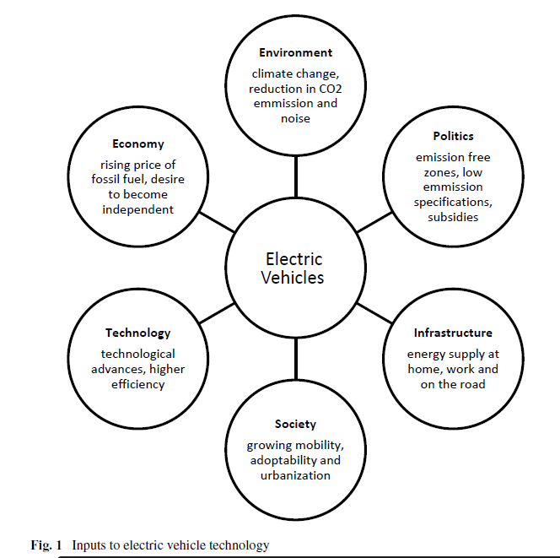

Slide 54
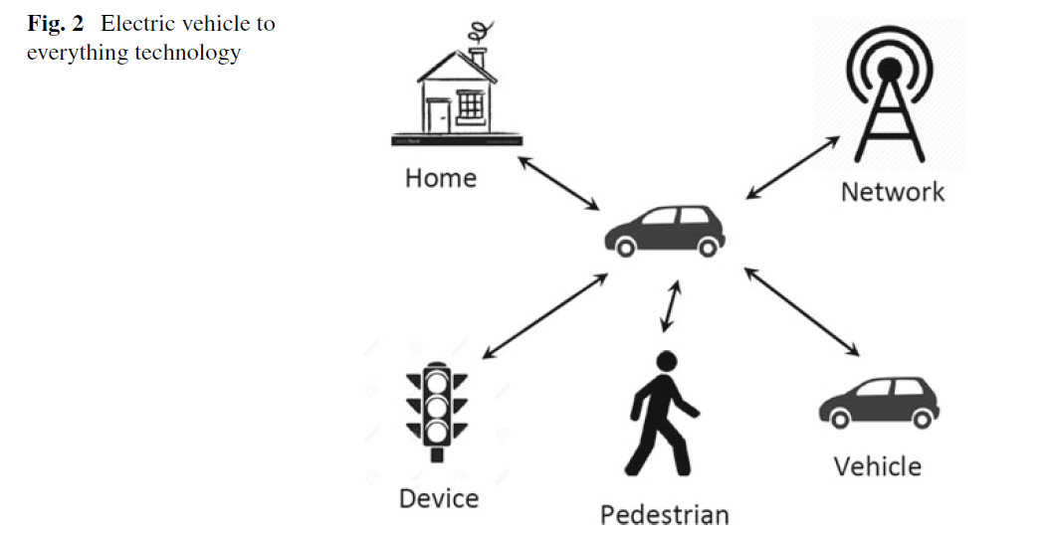

Slide 55
Motivation for Vehicle to Everything (V2X) and V2G Technology
Vehicle to everything is a partnership project using 4G LTE, C-V2X, or 5G network to support communication between vehicles to infrastructure (V2I), vehicle to network (V2N), vehicle to vehicle (V2V), vehicle to pedestrian (V2P), vehicle to device (V2D), and vehicle to grid
The cellular V2X (C-V2X) demands improved infrastructure capable of delivering economic and societal impact in terms of safe driving experience, reduced accidents, predictive travel, less greenhouse gas emission, and better traffic efficiency
It enables a growing set of applications such as forward collision warning, do not overtake, blind intersection at crossroads, queue warning, curve speed warning, road user alerts, discover parking and charging, optimal speed for traffic signal priority, emergency vehicle alert, etc..
The communication may be within the device to device (direct) for out of coverage area or via a network within coverage area

Slide 56
The gap between demand and supply may be filled with the ancillary services (reserves). Frequency regulation is the process of maintaining the system frequency to its predetermined value either by injecting a little power or by withdrawing power from the grid.
The power flow from vehicle to grid (V2G) may provide better frequency regulation as it is believed that at any instance, more than 90% of vehicles are parked. A vehicle battery can be viewed as a source of energy in between 10 and 30 kWh depending upon the size of the vehicle.
To exploit the potential of plug-in-electric vehicle (PEV), it needs to be connected to grid to supplement the generation.
This may relieve the utility from excess generation during peak hours and benefit the consumer in terms of reduced electricity charges due to saving in transmission cost.

Slide 57
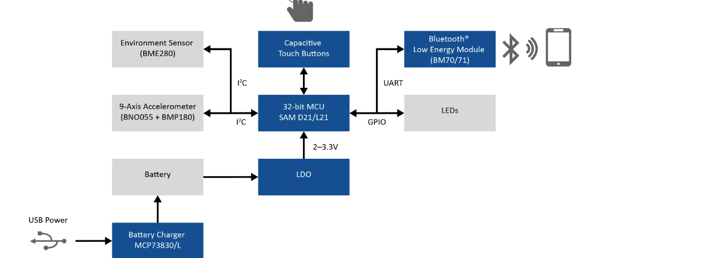
Weather monitoring using BLE(Bluetooth low energy)

Slide 58
Bluetooth is a useful technology for data transfers. It's now found in various devices and is popular for everything from music streaming to file sharing.
One disadvantage of Bluetooth is that it uses quite a bit of battery on your device. If you leave a Bluetooth connection on all day, the additional power consumption is noticeable.
This is particularly problematic for devices with limited power, such as those belonging to the Internet of Things, or even just your smartphone.

Slide 59
What Is Bluetooth?
Bluetooth is a short-range wireless technology standard. It utilizes UHF radio waves in the ISM bands from 2.402GHz to 2.48GHz.
It allows you to build personal area networks and to exchange data between nearby devices. It was originally created to provide an alternative to cables. Prior to its introduction, most PC peripherals were not wireless.

Slide 60
What Is Bluetooth Low Energy?
Bluetooth Low Energy is based on Bluetooth. It was released in 2011, and it is also referred to as Bluetooth Smart and Bluetooth 4.0.
BLE is designed to offer many of the same features as Bluetooth but focusing on low power. As a result, it is not as fast as Bluetooth and is not suitable for transferring large files. But it is ideal for transferring small amounts of data with minimal power consumption.
BLE has made it possible for a wide range of small IoT devices, such as sensors and tags, to communicate despite not having large batteries.

Slide 61
How Does BLE Use Less Power?
BLE uses the same radio wavebands as Bluetooth and allows two devices to exchange data in many of the same ways.
he difference is that BLE devices remain asleep in between connections. They are also designed to only communicate for a few seconds when they do connect.
This is in contrast to "Classic Bluetooth," which is always on and was designed for continuous communication that often lasts hours.
Switching off between transmissions allows BLE devices to communicate effectively at a fraction of the power. It's not uncommon for a BLE device to last for a year on a single battery.

Slide 62
How Secure Is Bluetooth Low Energy?
All BLE connections are equipped with AES-128 end-to-end encryption. This prevents data from being read if it's ever intercepted.
Man-in-the-Middle attacks are possible, but this can only happen for a limited period when two BLE devices are pairing.
The limited range of BLE is also beneficial from a security standpoint. Any attempt to hack a BLE device will require the hacker to get close to it.

Slide 63
How Secure Is Bluetooth Low Energy?
All BLE connections are equipped with AES-128 end-to-end encryption. This prevents data from being read if it's ever intercepted.
Man-in-the-Middle attacks are possible, but this can only happen for a limited period when two BLE devices are pairing.
The limited range of BLE is also beneficial from a security standpoint. Any attempt to hack a BLE device will require the hacker to get close to it.

Slide 64
he weather station is a device that is used to observe and gather data about the weather. It collects the most critical data, such as temperature, air pressure, and humidity. Here in this article, we will talk about the weather station that will be wirelessly sent to the Android Application. Hence, it needed a Bluetooth module for an interface. Thus, in this tutorial, we are making the Weather Station using RYB080I Bluetooth Low Energy (BLE) Module with Arduino.
So, the circuit is utilizing the RYB080I Bluetooth module. The RYB080I is a BLE module that supports Bluetooth v4.2 and v5.0. It includes a PCB-integrated antenna and is powered by a TI CC2640R2F ARM® Cortex®-M3 processor. Sending AT instructions to the module is all it takes to control it. The AT commands are used to verify connection status, set power mode, and scan Bluetooth devices, among other things.

Slide 65
Working Explanation
This Weather Station using RYB080I also uses a DHt11 sensor, which is suitable for a home weather station because it can monitor both temperature and humidity. So, when the supply is turned on, it gets readings from the environment, processes them in the controller according to the code, and displays them on the phone’s screen; the Bluetooth module is there to help with that.

Slide 66
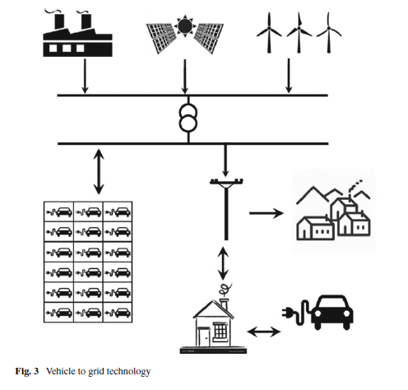
Electric Vehicles and Solar Power Plants in Smart Grid Environment

Slide 67
Both grid-connected and stand-alone solar power systems have been harnessed during last decades across the world. Grid-connected solar systems have been installed in developed countries, whereas stand-alone solar systems have been found suitable in remote villages where transmission of power proves uneconomical by the grid.
The Evs on the mainstream demand large electrical power demand which can be fulfilled by distributed generations in the form of solar power plants in sunny countries.
In smart grid environment, the combination of plugged in EVs and distributed solar power plant may provide better solution to the grid

Slide 68
The EVs may be allowed to charge during daytime from the solar power and may assist grid during peak hours when the demand is considerably high.
The on-grid multi-megawatt solar power plants requiremlarge surface areas, whereas distributed solar plants either on surface or on rooftop is a preferred alternative to contribute to the nationwide installed capacity

Slide 69
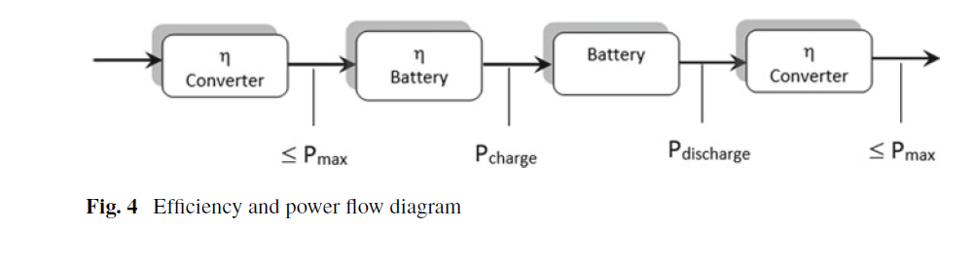

Slide 70
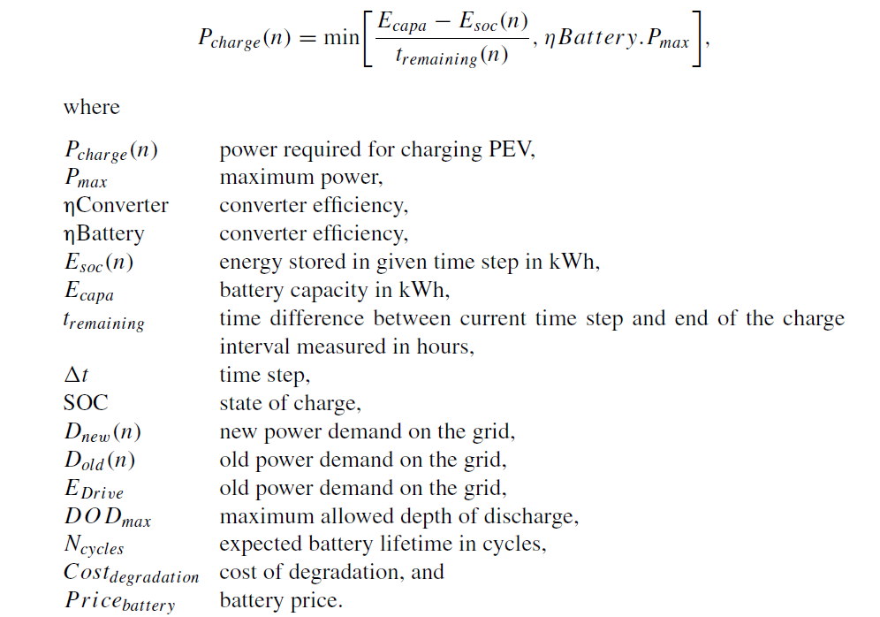

Slide 71
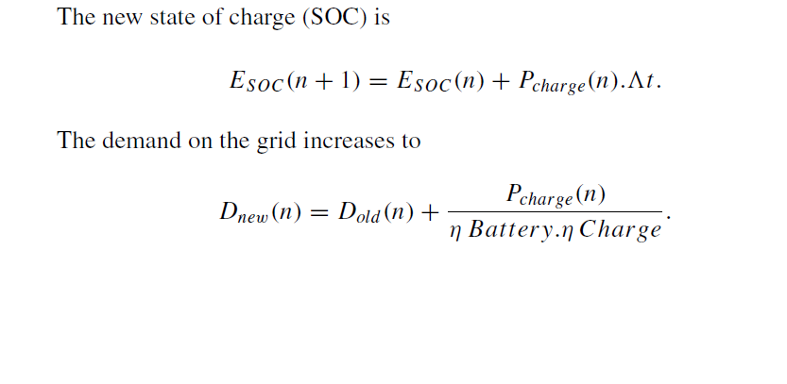
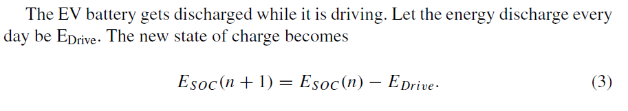

Slide 72
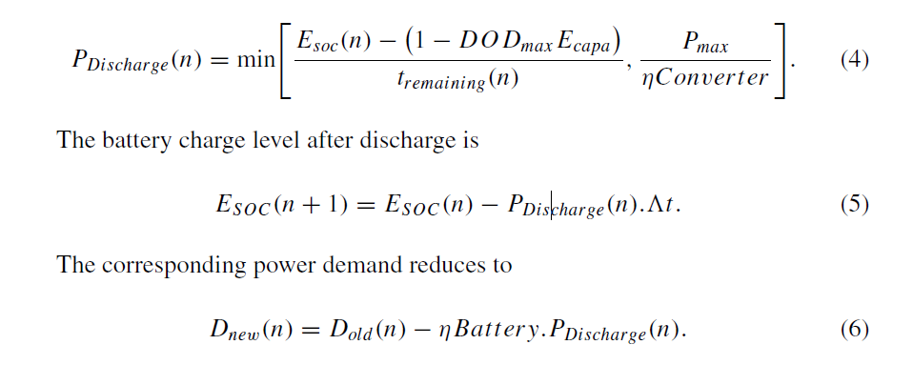
The power fed back to the grid may be expressed as

Slide 73
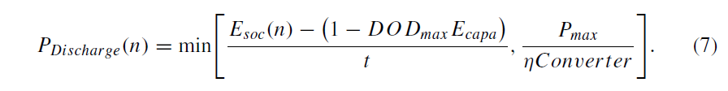
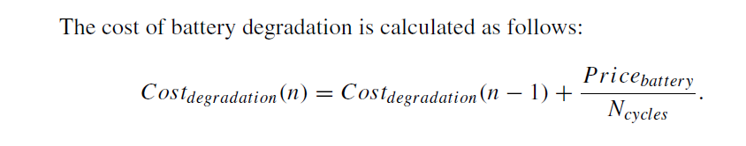
The discharge from each PEV is calculated using

Slide 74
Potential of EV to Grid Connection
In order to facilitate frequency regulation fromV2G, the power requirement is several megawatts.
Since each PEV can deploy a few kilowatts, it is necessary to aggregate the PEVs controlled by the operator.
The aggregator here means necessarily a parking area in commercial or residential complex.
It can be useful in regulation up and regulation down both. The regulation capacity estimation of aggregator largely depends upon the number of electric vehicles (EVs) in the parking area.
When the grid has deficit power, PEV injects power to the grid. Reverse happens when the grid has excess power

Slide 75
PEV injects power to the grid. Reverse happens when the grid has excess power. V2G supports regulation up by providing the shortfall known as reactive charging and supports regulation down when charging itself known as active charging.
It is important to note that if the battery is fully charged, EVs would not support regulation down.
Similarly, if the battery is fully exhausted, it would not support regulation up.
The fast response of EV batteries has the ability to correct the imbalance in generation and demand.
It may also provide reactive power support wherever needed.

Slide 76
The vehicle batteries have unique capability to provide faster real-time frequency regulation, and the EV owner may get financial benefits due to frequency regulation.
The aggregator needs to submit the resource capacity and price forecast.
The capacity payment to the aggregator is paid even when there is no actual power trade.
The actual regulation capacity varies as it depends upon the number of EVs with the aggregator
In order to facilitate the bidirectional power flow, V2G is equipped with grid connectivity, communication with grid and smartmeters.
PEV may be effective in regulation, frequency response, power factor regulation/correction, energy back up, peak management, minimize grid losses, and operating reserve.

Slide 77
Capacity Estimation of Aggregator
The participating EV is assumed to be autonomous and hence enter and exit the parking area (aggregator) as per owner’s schedule.
During active charging, EVs pay for energy consumed from the grid. However, when it supports regulation up (RU) or regulation down (RD), it receives payment for the service rendered.
It implies that the EV owner receives payment even when EV is charging (RD).
Such a charging is termed as active charging. During discharging, EV supports regulation up (RU).
All EVs registered with the aggregator are assumed to be heterogeneous with distinct capacity of their batteries

Slide 78
The state of charge (SOC) of the battery is defined as the ratio of energy stored in its battery to its maximum capacity.
The SOC of EV is expressed as zero when it is fully discharged and equal to unity when it is fully charged.
The target SOC is defined as the state of charge which an EVwish to acquire before it leaves the aggregator.
The minimum threshold state of charge (xi min) may be higher for a vehicle if it travels a lot between two successive charging, whereas lower value of xi min may be sufficient for another vehicle which is charged very frequently.

Slide 79
The minimum value of SOC is always maintained as xi min > 0, and the maximum value of SOC is always less than unity xi max < 1 giving further scope of regulation down (RD). An EV with SOC less than xi min is plugged in to achieve xi min due to active charging.
The active charging stops when EV achieves xi max. The SOC is categorized into three states as State 1: xi (t) ≤ xi min, offers regulation down; State 2: xi min ≤ xi (t) ≤ xi max, the state offers both regulation up and regulation down and hence prone to system oscillations due to instability; State 3: xi (t) ≥ xi max, offers regulation up.

Slide 80
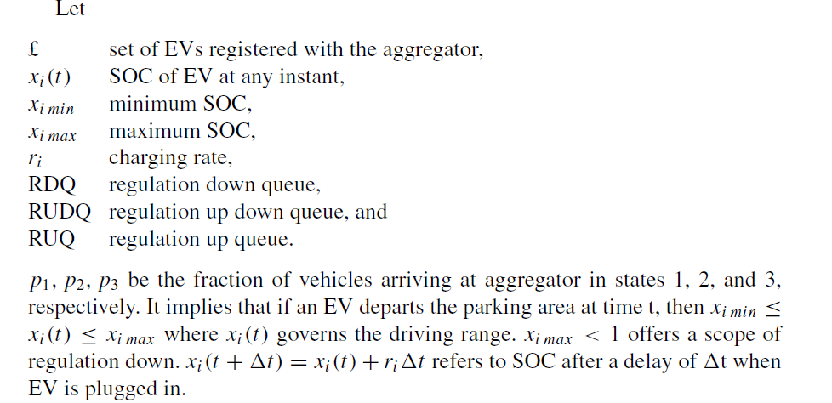

Slide 81
The regulation contracts between the aggregator and the grid operator may be
(i) Regulation down (EV charging) with constraints xi min = xi max = 0 assuming all batteries are fully discharged leading to maximize the profit.
(ii) Regulation up (EV discharging) with constraints xi min = xi max = 1 assuming all batteries are fully charged leading to maximize the profit.
(iii) Regulation up and regulation down with constraints 0 ≤ xi (t) ≤ 1. This helps in balancing the power demand and supply.

Slide 82
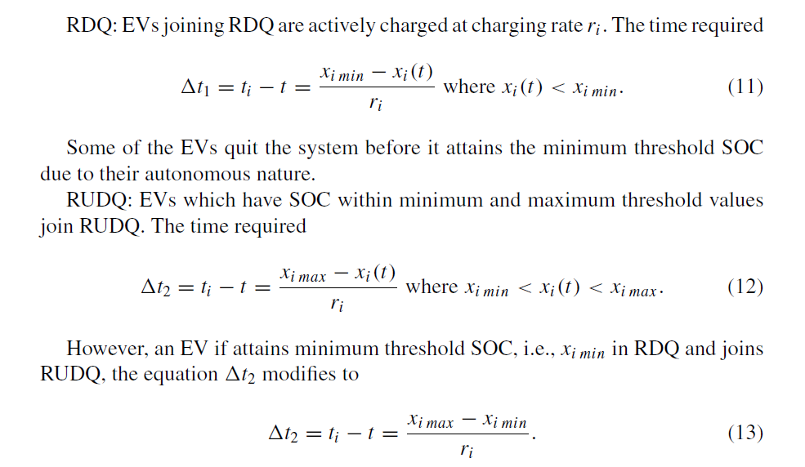

Slide 83
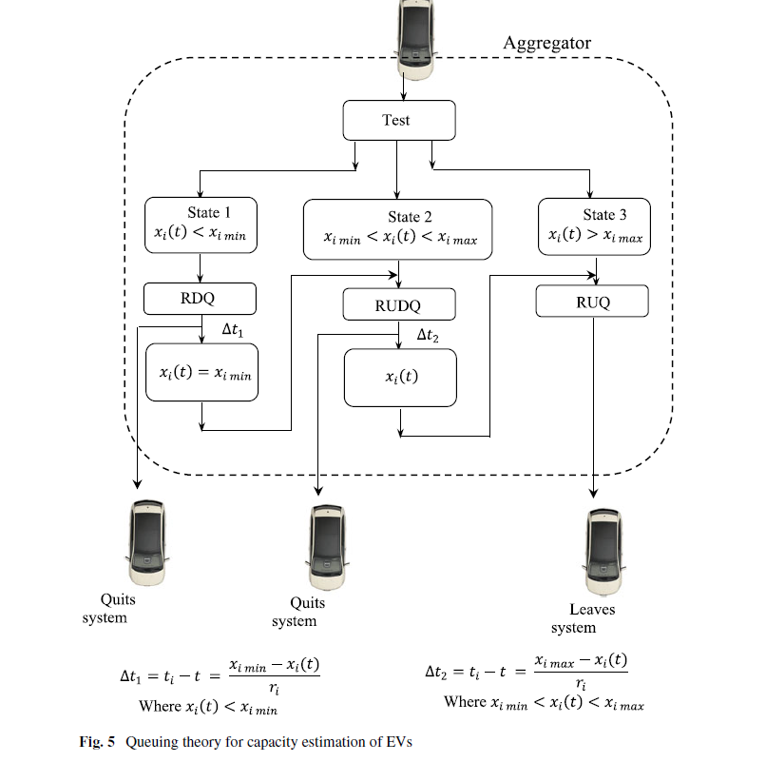

Slide 84
Battery Management System

